Slide 1
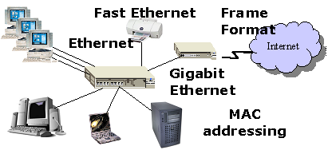
OSNF
LECTURE
Ethernet Fundamentals
PART 1
Diploma in CSF/IT
Year 1 (2021/22), Semester 2
Notes:
Left-hand Bar – Replace FSP by your module code and X by the lecture number.
Replace Lecture Title
Replace < Module Name >
Replace Year and Semester if necessary

Slide 2
Objectives
At the end of this session, you will be able to:
Compare and contrast the various Ethernet standards
Explain the MAC Addressing
Interpret the Ethernet Frame Structure
Notes:
Recall network hardware component: Network Interface Controller (or Network Adapter).
Ethernet is a protocol designed to take care of communication requirements in a LAN (Network Interface in TCP/IP Suite).

Slide 3
TCP/IP Protocol Suite
Protocol Layer
HTTP, DHCP, DNS, FTP etc.
Application
TCP, UDP
Transport
IP
Internet
ARP
Network Interface
Data Link
Physical
Ethernet, Wireless LAN
Transmission Medium (e.g. UTP, Fibre, Wireless)

Slide 4
Introduction to Ethernet
Ethernet is the most popular LAN technology in the world.
A family of Ethernet LAN technologies which include:
Fast Ethernet (100BaseTX)
Gigabit Ethernet (1000BaseT, 1000Base-SX, 1000Base-LX)
10 Gigabit Ethernet

Slide 5
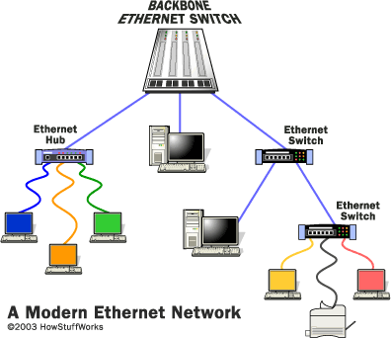
Ethernet Network
A simple Ethernet LAN uses a switch to connect different devices in a network.
→ Star topology
Notes:
Note:
Hubs has been replaced by Switches
Wireless APs operate like Hubs

Slide 6
Activity 1: Ethernet Standards
Different Ethernet standard has different physical specifications: speed/data rate, cabling, connector, distance limitation, etc.
Watch a video on Ethernet Standards and complete the following table.
2018 video
https://www.youtube.com/watch?v=X8MofnwqOSI
2015 video (up to 5min 15sec) – for reference only
https://www.youtube.com/watch?v=qrkniffKDjE

Slide 7
Activity 1: Ethernet Standards – cont.
Standard | Speed | Cable Type | Maximum Distance
100Base-TX | 100 Mbps | Copper (T/TX) | 100m
1000Base-T | 1000 Mbps or 1 Gbps | Copper (T/TX) | 100m
1000Base-SX (short d) 1000Base-LX(long d) | 1000 Mbps or 1 Gbps 1000Mbps / 1 Gbps | Fiber Optic (FO) multi-mode Fiber Optic single mode | 500m 5km
10GBase-T | 10 Gbps | Copper | CAT6(55m) CAT6A(100m) CAT7(100m)
10GBase-SR 10GBase-LR | 10Gbps | Multi-mode fiber Single-mode fiber | 300m 10km
(SR – short reach; LR – long reach)

Slide 8
Activity 1: Ethernet Standards – cont.
What does Ethernet Standard: 1000Base-T means?
1000 refers to the ___________Speed_____________
Base is the abbreviation for _______Baseband____________
T stands for __________Twisted pair_____________
What is the name for:
100Base-TX -> ________Fast Ethernet_____
1000Base-T -> ________1 Giga Ethernet____________
10GBase-T -> _______10 Giga Ethernet______________

Slide 9
Backward Compatibility
Most new equipment support Gigabit Ethernet but are also backward compatible with older (slower) standards
Notes:
10 Gig Ethernet is backward compatible with Gigabit Ethernet and Fast Ethernet

Slide 10
Ethernet Layers
Ethernet specifies:
Physical (PHY) Layer: baseband signaling/transmission method over transmission medium
Media Access Control (MAC) Layer: which include addressing and frame structure
Notes:
ETHERNET / IEEE 802.3
Ethernet is standardized as IEEE 802.3, a LAN standard which is the most commonly used.
IEEE 802.3 is a collection of IEEE standards (based on Ethernet) that define:
-Physical specification which includes physical transmission medium and signaling method
-Media Access Control (MAC) specification which includes addressing and frame structure
Ethernet standards describe:
-Physical specification:
physical transmission medium e.g. UTP, optical fibre
signaling method e.g. baseband
-Media Access Control (MAC) specification:
MAC addressing (identify the Ethernet NIC/Adapter in computer, laptop, network printer or network device)
Ethernet frame structure (like the structure of a letter)
Medium access control method (control access to a shared physical medium by multiple devices)

Slide 11
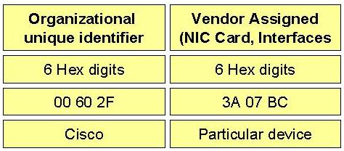
Ethernet MAC Addressing
Ethernet MAC is responsible for addressing (MAC addresses).
The MAC address is the physical hardware address (burned-in to the adapter); it is 6 bytes long (48 bit) consisting of two parts viz Organizational unique identifier and a vendor assigned part.
Every MAC address is unique i.e. No two MAC addresses can be the same.
MAC addresses are expressed as 6 pairs of hexadecimal digits.

Slide 12
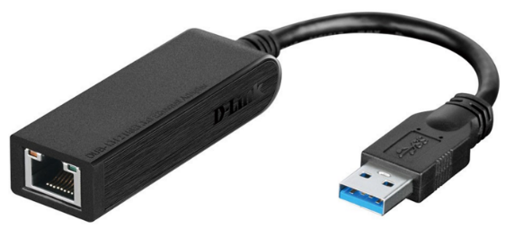
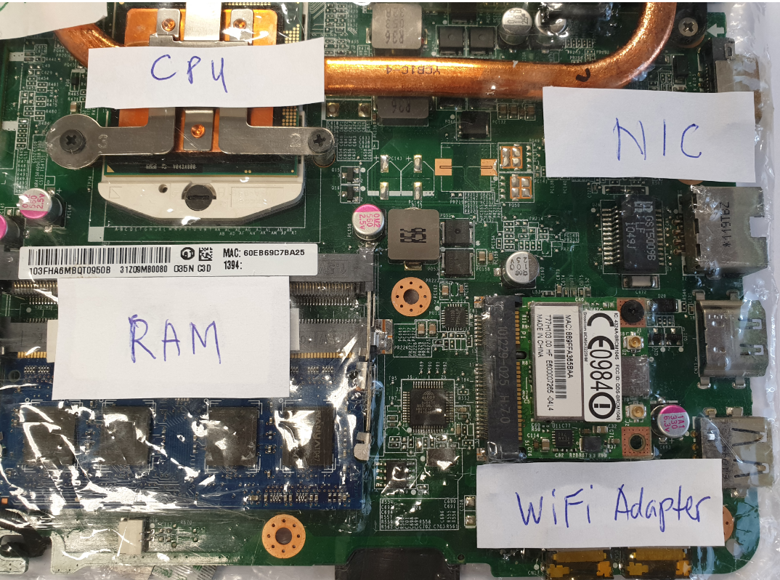
Ethernet MAC Addressing – cont.
48 bit physical address is burned-in to the Ethernet Network Interface Controller (NIC) or Adapter by the vendor/manufacturer.
Computing devices (PCs, notebooks) have built-in Ethernet Adapters.
USB Ethernet Adapter
MAC address is also known as: - Physical address - NIC address - Adapter address - Ethernet address - Hardware address

Slide 13
Activity 2: MAC Address
From your laptop, start command prompt.
Enter > ipconfig /all
Write down:
MAC address of wireless LAN adapter
MAC address of LAN adapter (if available on your laptop)

Slide 14
Ethernet Frame Structure
Ethernet is responsible for framing data and preparing them for transmission on the network.
A data packet is encapsulated with a header and trailer
Header: Control information placed before data when encapsulating that data for network transmission
Trailer: For error detection.
Data Field: consists of upper layer protocol (e.g. IP, ARP, etc.)

Slide 15
Activity 3: Ethernet Frame Structure
Rearrange the sequence of the following fields accordingly.
FCS : Frame Check Sequence (FCS) refers to an error-detecting code added to a frame. FCS field contains a value that is calculated by source device based on the fields in the frame. This value is added to the end of the frame that is sent. When destination device receives the frame, FCS value is recalculated based on the fields in the received frame & compared with the transmitted FCS value. If the two values are different, an error is detected & the frame is discarded. If values matched, no error occurred.
Preamble: An alternating 1, 0 pattern at start of each frame to allow receiving device to lock the incoming bit stream (frame synchronization).
Destination MAC: MAC address of receiver. Used by receiving devices to determine if an incoming packet is addressed to its NIC.
Source MAC: MAC Address of sender.
Type: Identifies the upper layer protocol (e.g. 0x0800 = IP, 0x0806 = ARP)
Data: Protocol Data Unit from upper layer (e.g. IP packet). If length <46 bytes, padding is done. Maximum transmission unit is 1500 bytes
Notes:
There are two versions of Ethernet in current use:
- Ethernet II
- IEEE 802.3
The difference is in the frame structure: IEEE 802.3 uses Length of Data Field while Ethernet II uses Type (or Ethertype) to indicate which upper layer protocol data unit is encapsulated in the Data (or payload) of an Ethernet Frame.
For IEEE 802.3 Frame, the Preamble (8 bytes) comprises:
- Preamble, 7 bytes of 10101010
- Start of Frame Delimiter (SFD) –1 byte of 10101011 (note the double 1’s indicates that the frame starts after this)
Data Field – PDU of next higher protocol encapsulated by Ethernet.
- If data is less than 46, data is padded with 0’s until total data length is 46
- Upper protocol will be configured to be have a maximum transmission unit (MTU) of 1500 bytes

Slide 16
Activity 3: Ethernet Frame Structure – cont.
Fill in the boxes below to show the correct fields and length of Ethernet frame:
2
(8 bytes)
3
(6 bytes)
4
(6 bytes)
5
(2 bytes)
6
(46-1500 bytes)
1
(4 bytes)
FCS 2. Preamble 3. DestMacAddr
4. Source Mac Addr 5. Type 6.Data
P D S T D F
Please Don’t Start The Data First

Slide 17
How NIC Uses Frame Structure & MAC Addresses?
Source device builds a data frame. The frame consists of:
MAC address of the destination device - Destination Address
Its own MAC address - Source Address.
All devices on the LAN see the frame.
Only the receiver’s NIC recognizes its MAC address in the Destination Address field.
Destination device copies and processes the frame.

Slide 18
Summary
Ethernet standard:
Fast Ethernet (100Mbps)
Gigabit Ethernet (1000Mbps or 1Gbps)
10 Gigabit Ethernet (10Gbps)
Ethernet MAC organizes data into frames before sending it onto the physical in a network.
Ethernet specifies the following:
MAC Specification:
MAC Addressing
Ethernet Frame Structure (Destination, Source, Type, Data, FCS)
Physical (PHY) Specification:
e.g. 1000BaseT

